Slide 1


July 2022
Predicting Austin House Prices
STA 380: Group Project
Samarth Mishra, Sai Bhargav, Peyton Lewis, Ryan Lee, Srividya Rayaprolu, Muskaan Singhania

Slide 2






Meet the Team
Srividya Rayaprolu
Muskaan Singhania
Ryan Lee
Sai Bhargav
Samarth Mishra
Peyton Lewis

Slide 3
Problem Statement
Austin is among the top 10 real estate markets in USA. More people are moving to Austin as a result of its fast growing economic sector, which is raising housing demand.
As students at UT Austin, we were interested in learning what influences housing prices and by how much. We worked with data from Zillow from 2018 to 2021.

Slide 4
Understanding the Dataset
Location
Area
Schools nearby
HOA
Rooms
Features
Tax Rate
Type
House Price
What are the variables that affect the housing prices?
The dataset consists of 15,171 rows with 45 variables
- Categorical
- Quantitative
Source: Kaggle Dataset using a webscraper on Zillow

Slide 5
Approach
Exploratory Data Analysis
Feature Selection
Data Preparation
Modelling
Model Improvement
Model Selection
Correlation Matrix
Scatter Plots
Outlier Analysis
11 variables out of 45 variables selected
Filtering the dataset
Linear Regression
KNN
Trees – Random Forest, Bagging, Boosting
Hyper Parameter Tuning
Lasso Modeling
Ridge Regression
Bagging
Test RMSE Analysis

Slide 6
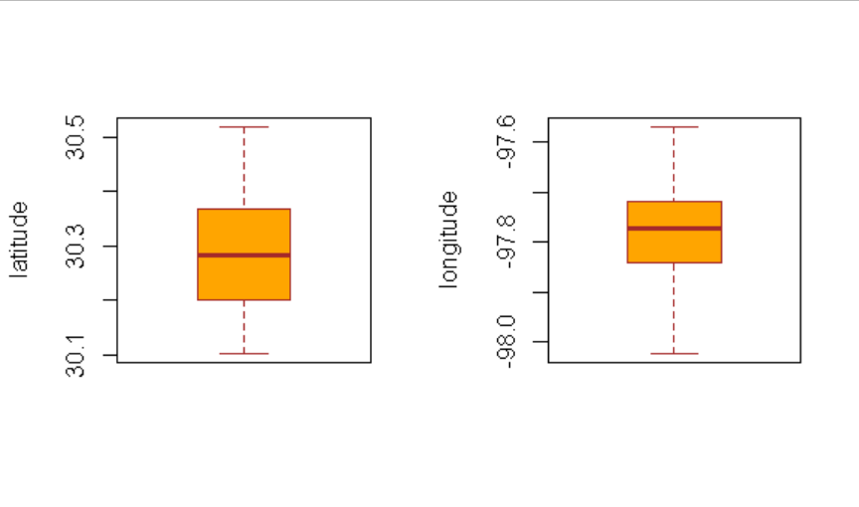
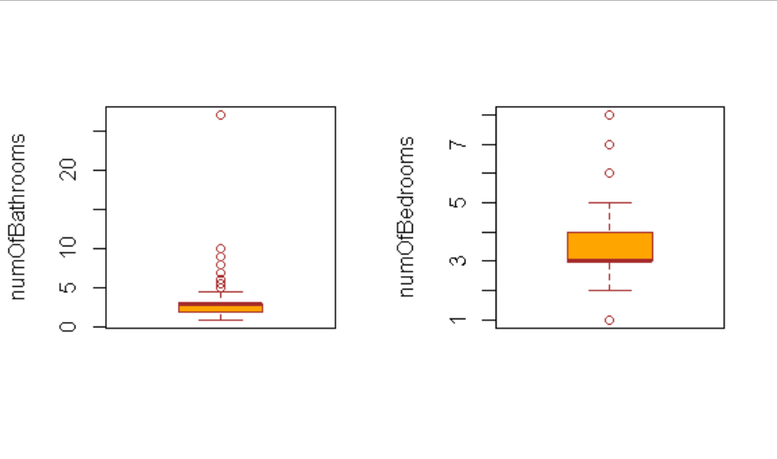
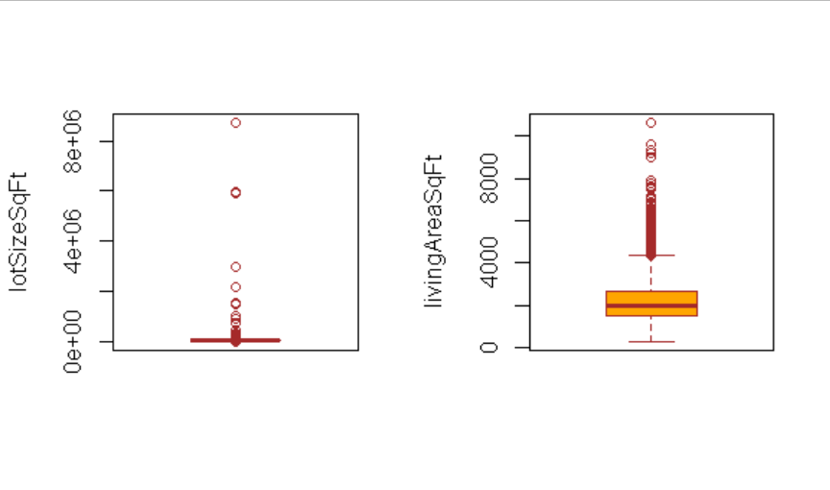
Outlier Analysis
Boxplots and scatter plots were analysed to remove outliers.
IQR and Z score method yielded similar results.
Outliers removed to improve model accuracy

Slide 7
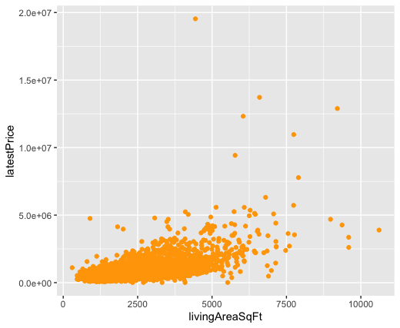
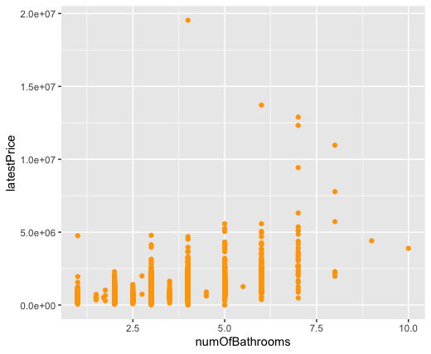
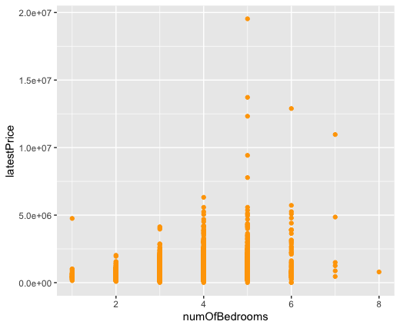
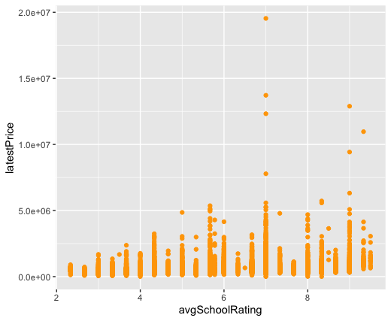
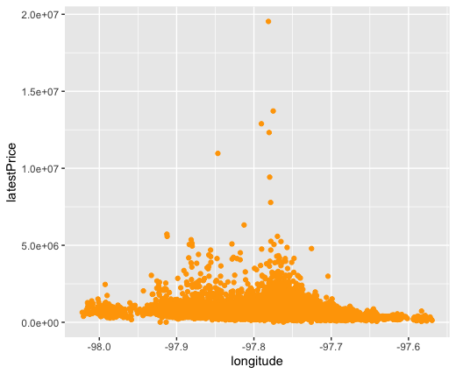
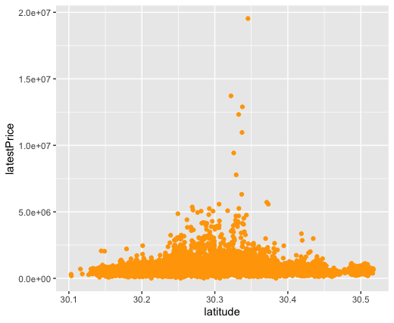
Exploratory Data Analysis
Exploratory Data Analysis
Feature Selection
Data Preparation
Modelling
Model Improvement
Model Selection
X variable | Correlation with latestPrice
livingAreaSqFt | 0.5616
numOfBathrooms | 0.4965
numOfBedrooms | 0.3072
avgSchoolRating | 0.2877
longitude | -0.1563
latitude | 0.0688
propertyTaxRate | -0.0649
lotSizeSqFt | 0.0309
numPriceChanges | 0.0265
age | -0.0229
hasAssociation | -0.0171

Slide 8
Feature Selection
Exploratory Data Analysis
Feature Selection
Data Preparation
Modelling
Model Improvement
Model Selection
45 features and the target variable: latestPrice
Narrowed down to 11 features based on intuition
Validation of the selection
Notes:
Our dataset consists of 45 features and the target column i.e. the latest price of the listing on Zillow
Based on business intuition, we narrowed down to 11 features that would be used to predict our target variable
We further validated our hypothesis by running a correlation and feature importance on the 45 features and found that the 10 selected features were the most linearly correlated and important in the Linear and Random Forest models respectively

Slide 9
Data Preparation - Transformation
Exploratory Data Analysis
Feature Selection
Data Preparation
Modelling
Model Improvement
Model Selection
latestPrice adjusted for Inflation
Categorical Columns encoded as 0 & 1
Transformed yearBuilt → age
Notes:
Adjustment of the target variable
The target variable latestPrice is the latest price of the listing as per the latest sale date
The target variable latestPrice was adjusted for inflation depending on how much the median house prices has appreciated over the years
Transformation of the feature columns
Categorical columns have been encoded as 0 & 1
Transfomed the yearBuilt column to age of house column

Slide 10
Data Preparation - Filters
Variable | Filters | % of Dataset
Home Type | Single Family | 94 %
City | Austin | 99 %
hasSpa | False | 92 %
hasHeating | True | 98 %
hasCooling | True | 99 %
numOfBathrooms and numOfBedrooms | Non-zero | 99 %
Notes:
Since we had so many features, we didn’t want categories that constituted 1-5% to skew our analysis
We have put the following filters on the data
Limited the data to ‘Single Family’ home type
Limited the data to the houses that didn’t contain Spa
Eliminated the houses outside of Austin (ex: Pflugerville)
Eliminated the houses with ‘0’ bed & bath
Limited the data to houses that had heating and cooling

Slide 11
Linear Model
Exploratory Data Analysis
Feature Selection
Data Preparation
Modelling
Model Improvement
Model Selection
Multivariable Linear Model – Baseline
Log-Linear Model
Ridge Regression
Lasso Model

Slide 12
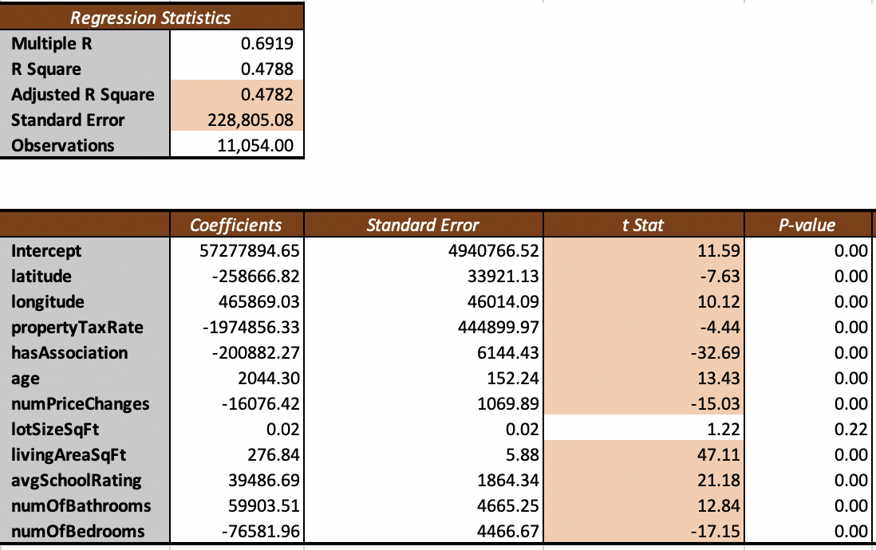
Multivariable Linear Model - Baseline

Slide 13
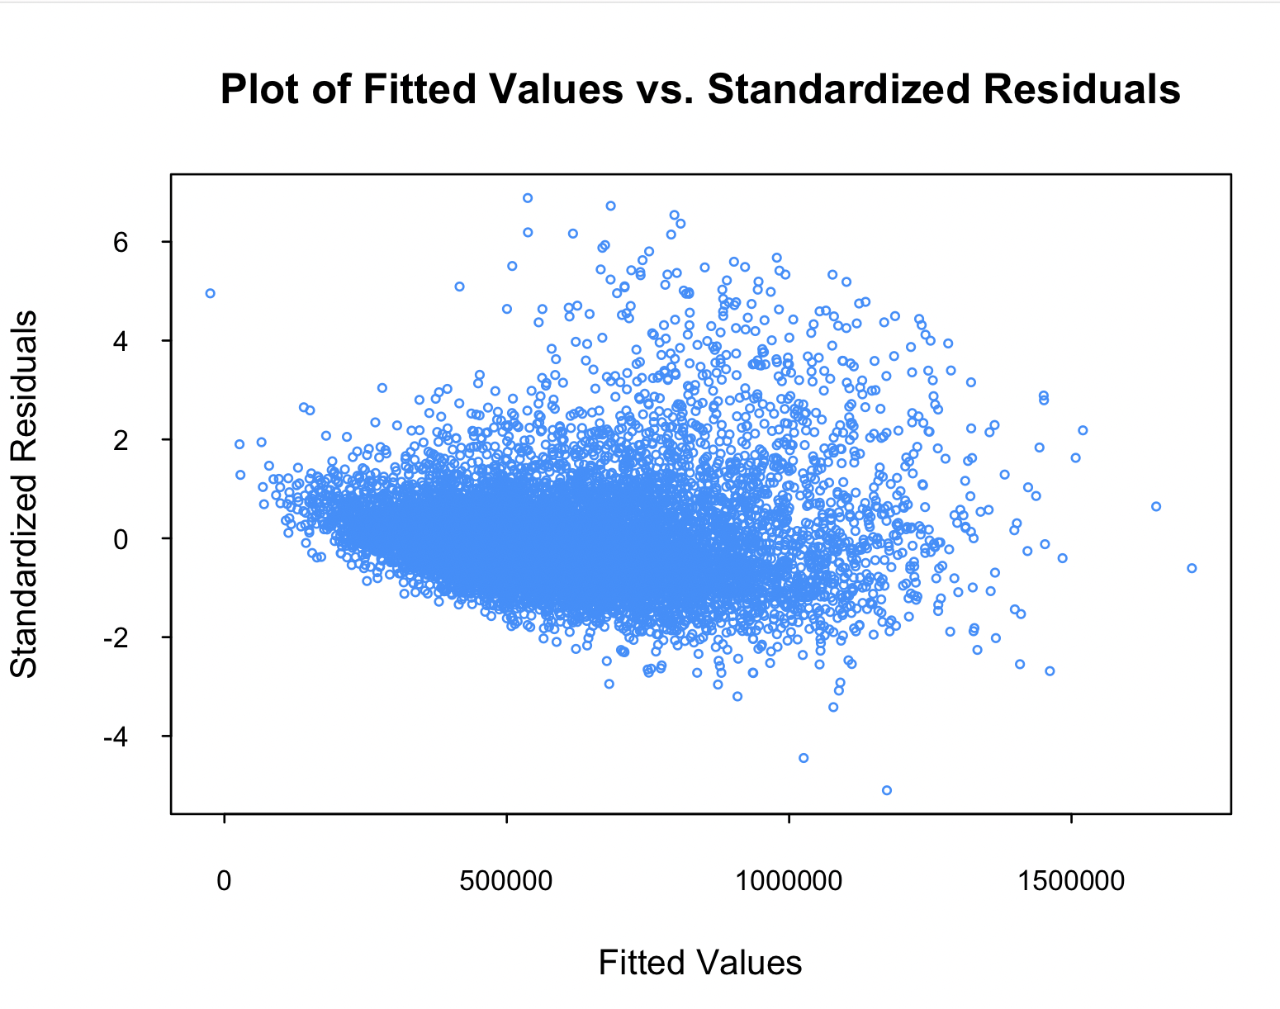
Heteroskedasticity

Slide 14
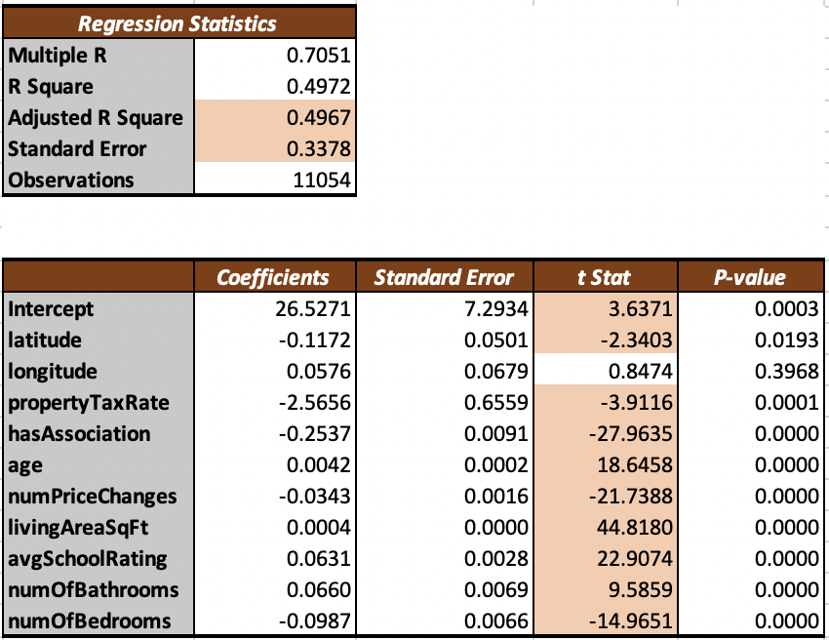
Log-Linear Model

Slide 15
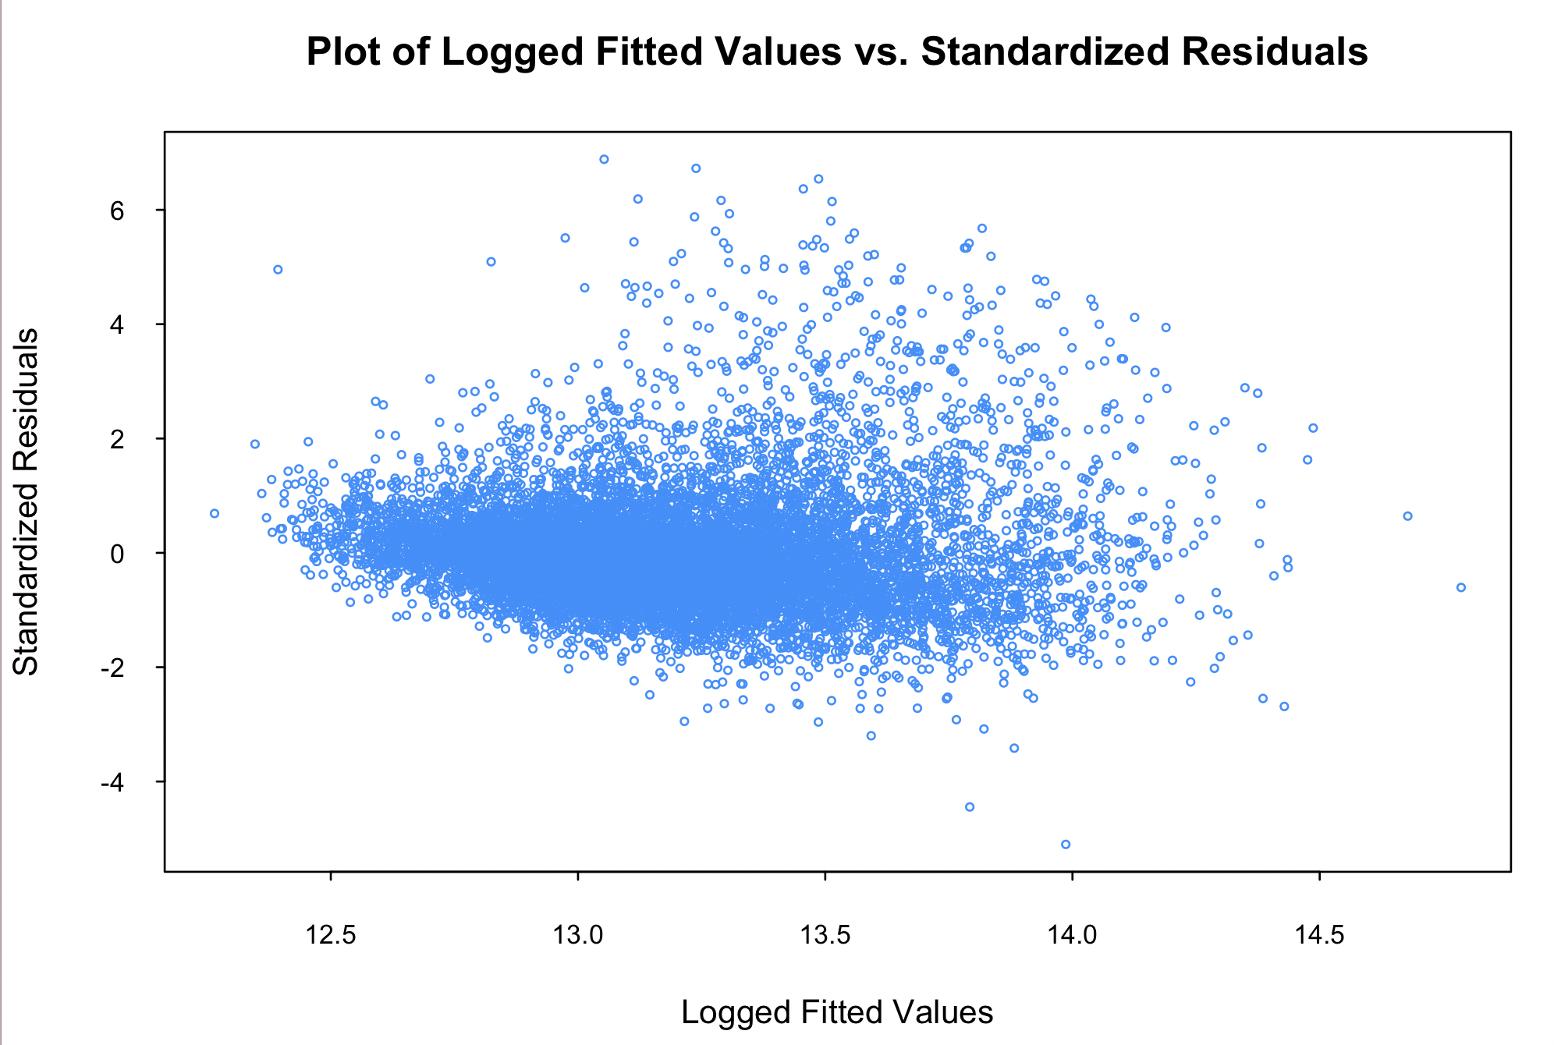
Log-Linear Model

Slide 16
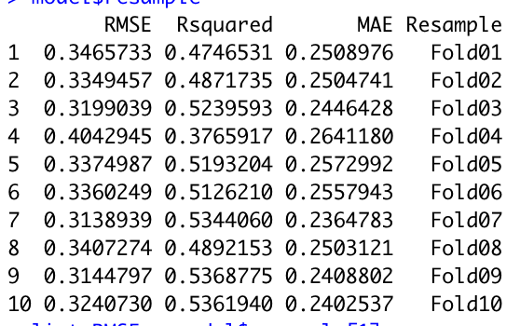
Log-Linear Model: K-Fold CV

Slide 17
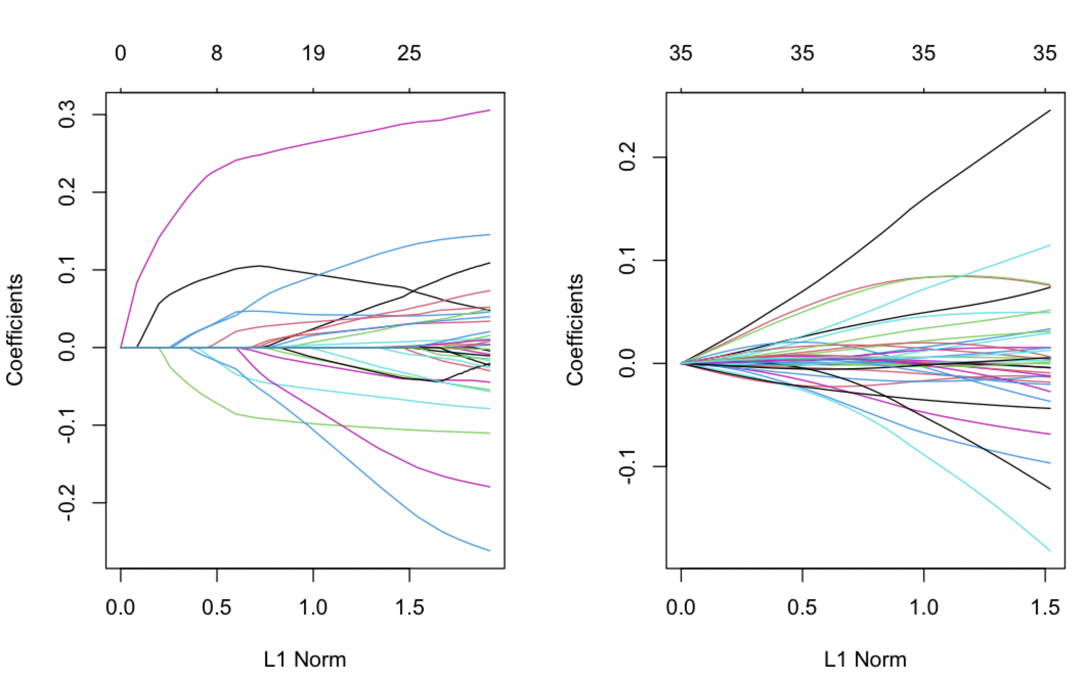
Lasso Model
Ridge Regression

Slide 18
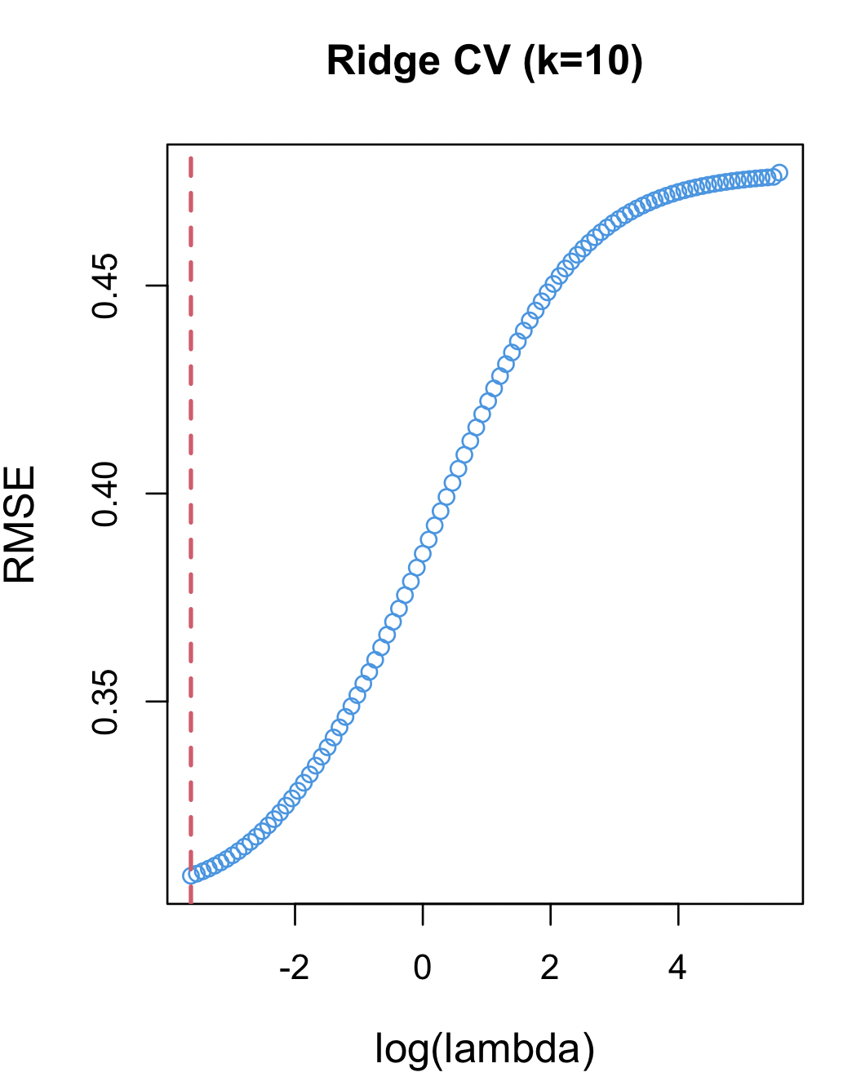
Ridge Regression: K-Fold CV
Minimum Lambda: 0.02653
Test RMSE: 0.30810

Slide 19
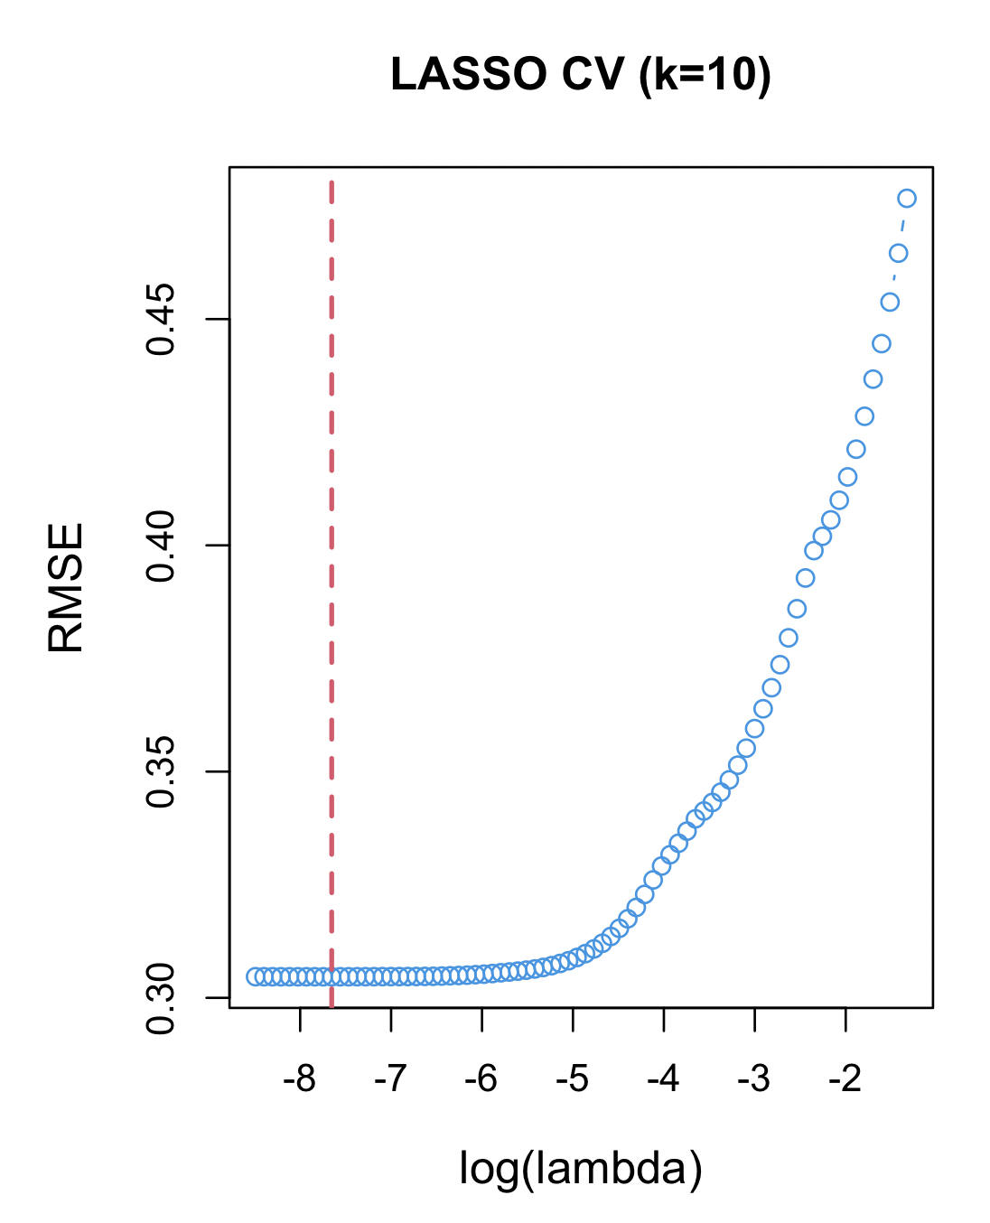
Lasso Model: K-Fold CV
Minimum Lambda: 0.000475
Test RMSE: 0.30465

Slide 20
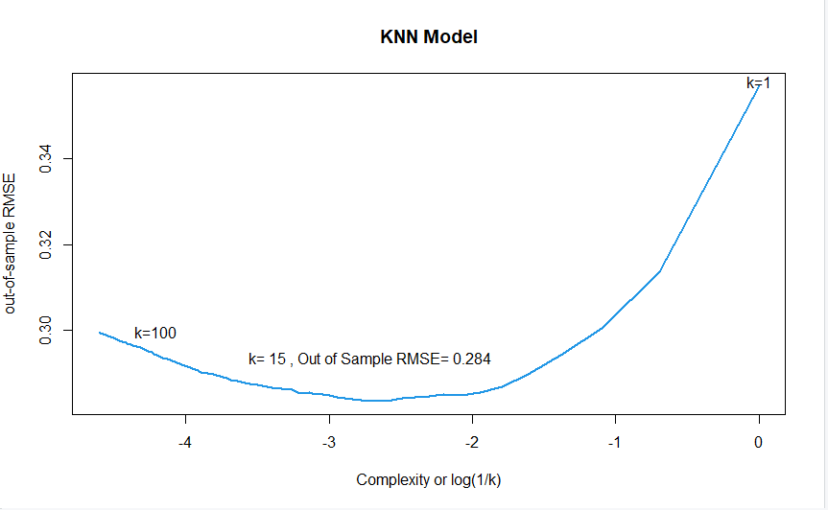
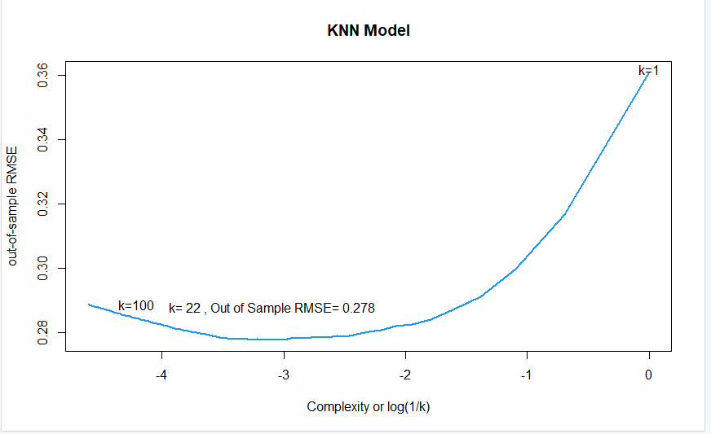
K-Nearest Neighbors: Weighted & Unweighted
Unweighted KNN
(After Feature Selection)
Unweighted KNN

Slide 21
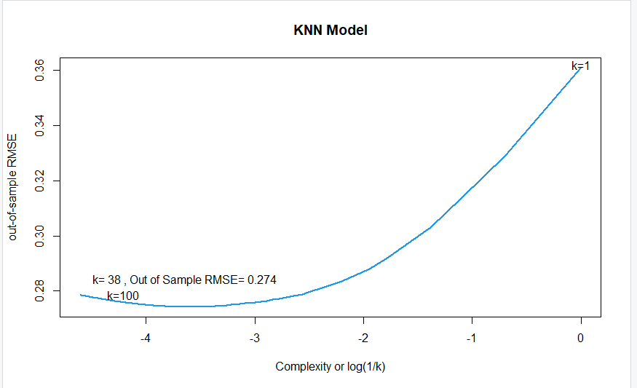
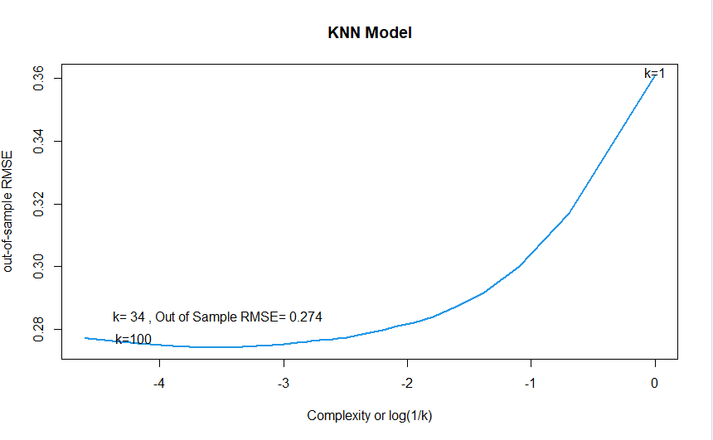
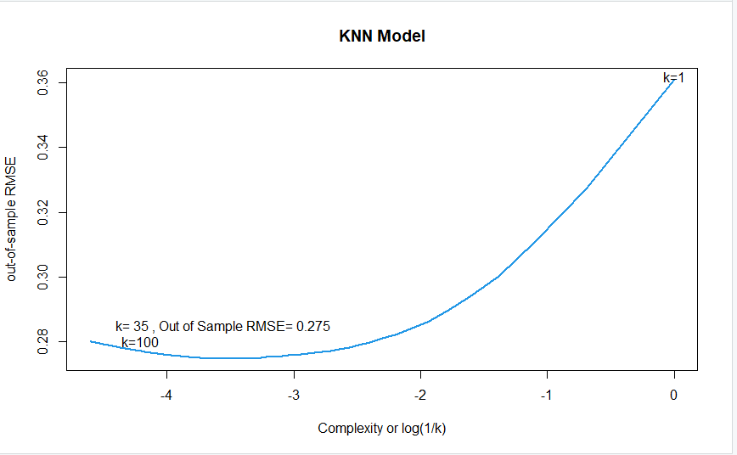
Weighted KNN
Triangular
Gaussian
Epanechnikov
Kernel Used | Test RMSE
Triangular | 0.274
Gaussian | 0.274
Epanechnikov | 0.275

Slide 22
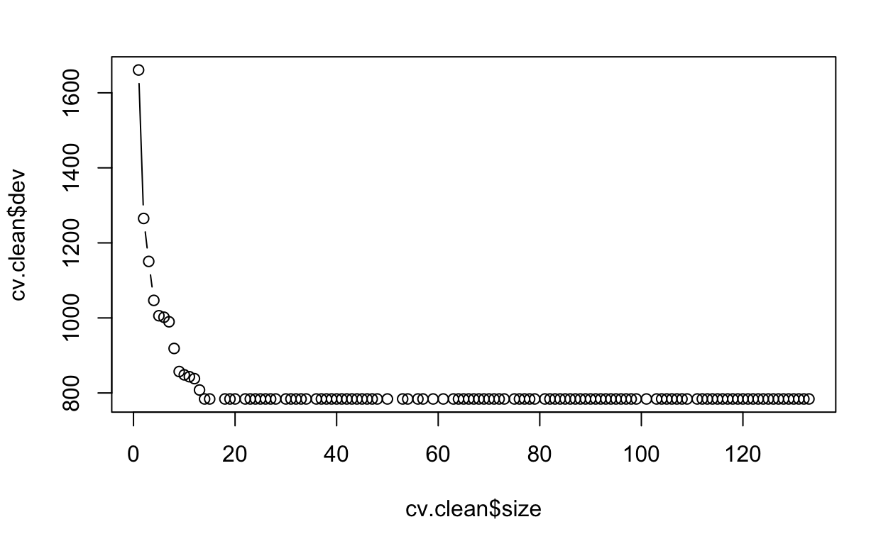
Fitting Regression Tree
Before pruning:
# of terminal nodes = 133
Test RMSE =
Tree size = 20
0.3092

Slide 23
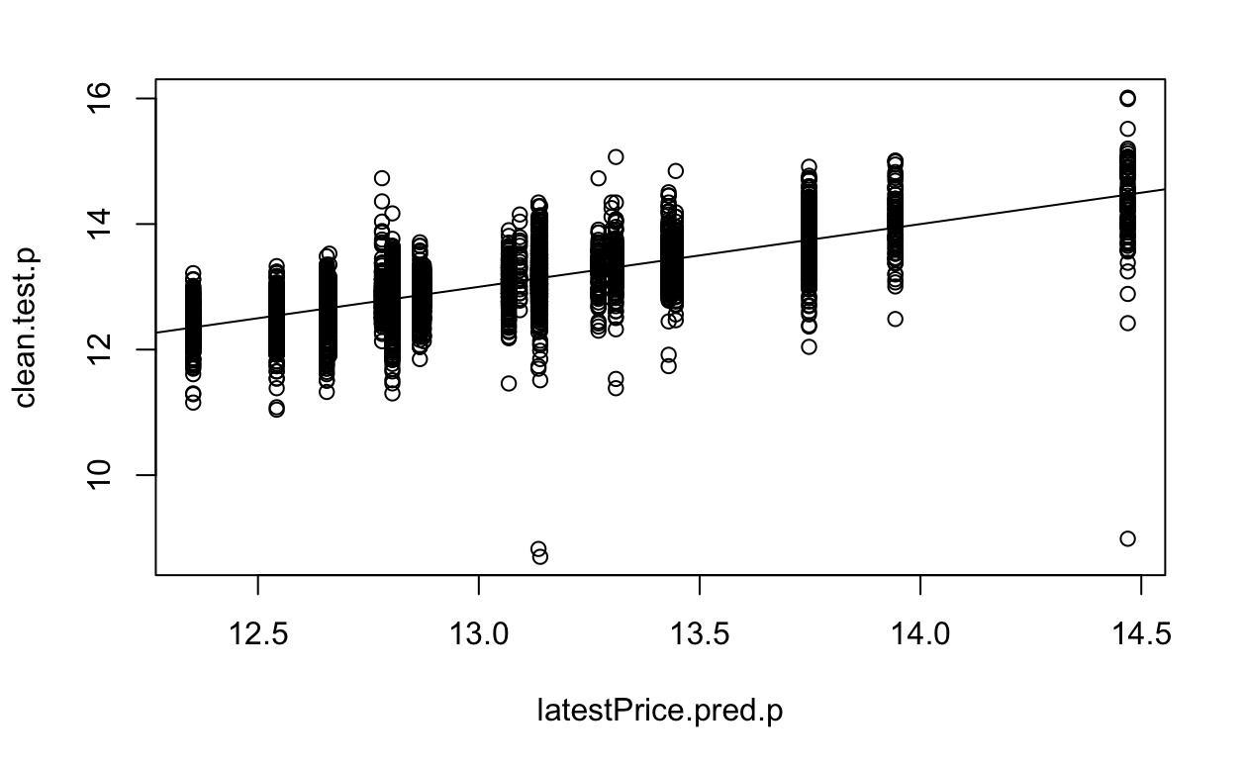
Fitting Regression Tree
For a tree size of 20,
Test RMSE =
0.3358

Slide 24
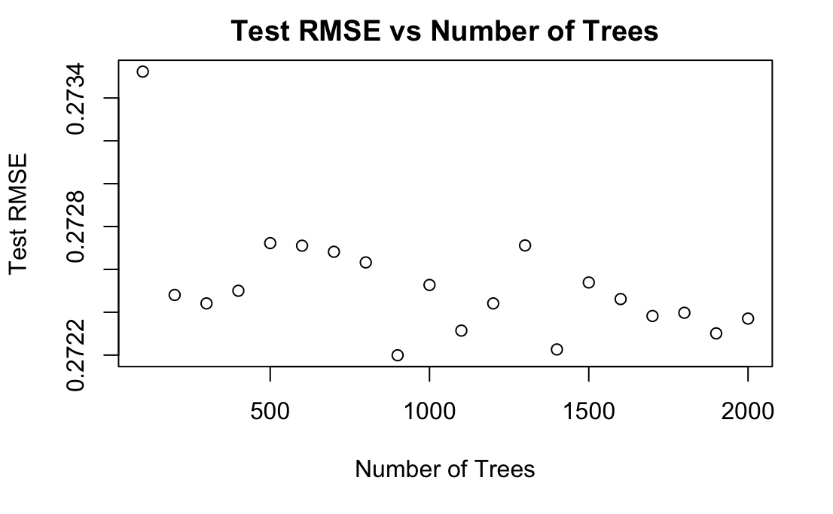
Bagging
Exploratory Data Analysis
Feature Selection
Data Preparation
Modelling
Model Improvement
Model Selection
# of Predictors at Each Split: 10
# of Trees: 100 : 2000

Slide 25
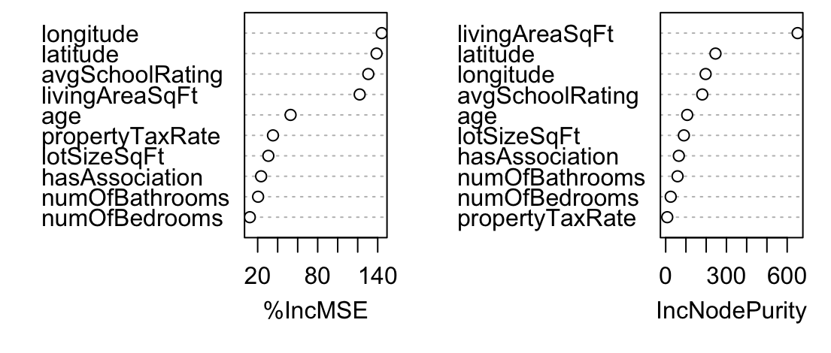
Bagging
 | % Variance Explained
Train | 73.47
Test | 72.47
# of Predictors at Each Split: 10
# of Trees: 900
Test RMSE:
0.2722

Slide 26
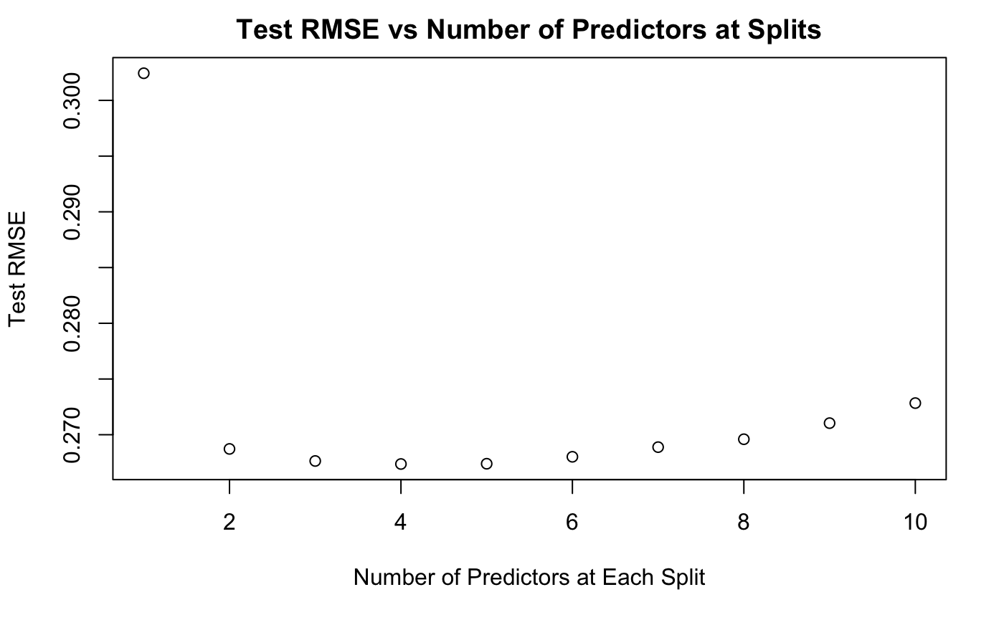
Random Forest
Exploratory Data Analysis
Feature Selection
Data Preparation
Modelling
Model Improvement
Model Selection
# of Predictors at Each Split: 4
% Variance Explained = 74.47%
# of Trees: 500
Test RMSE:
4
0.2674

Slide 27
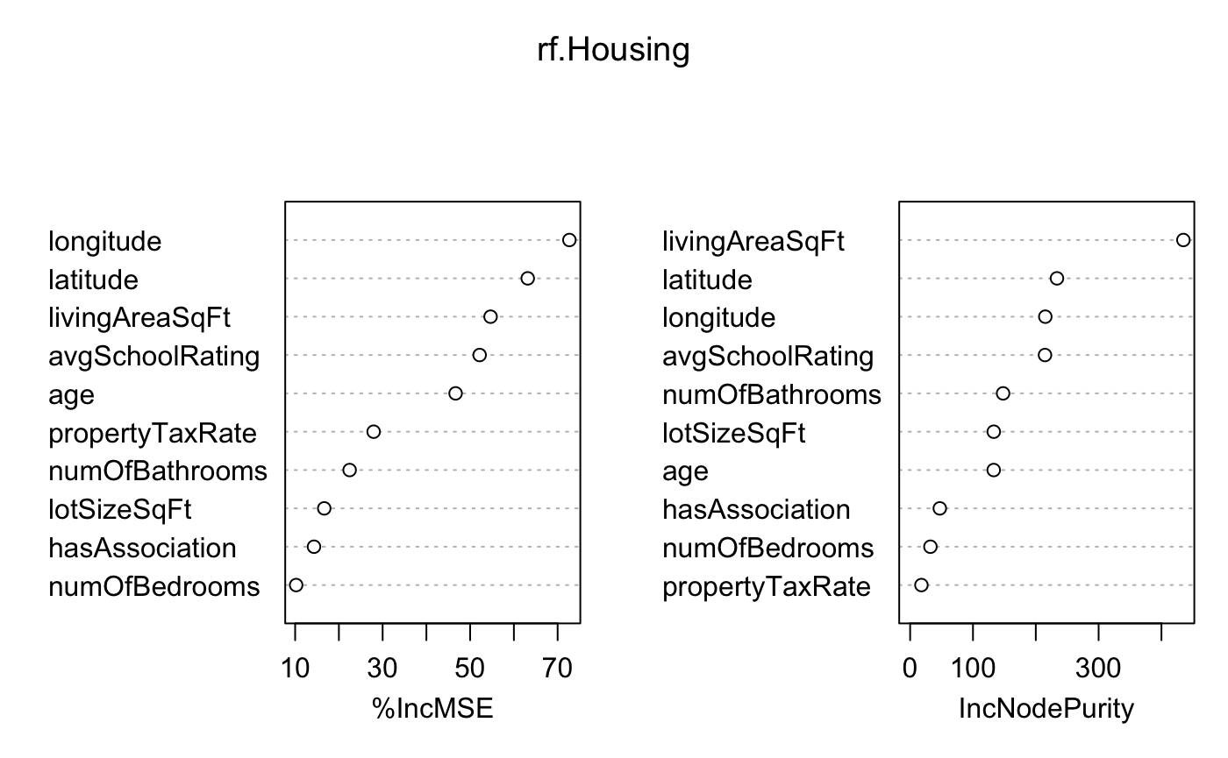
Random Forest

Slide 28
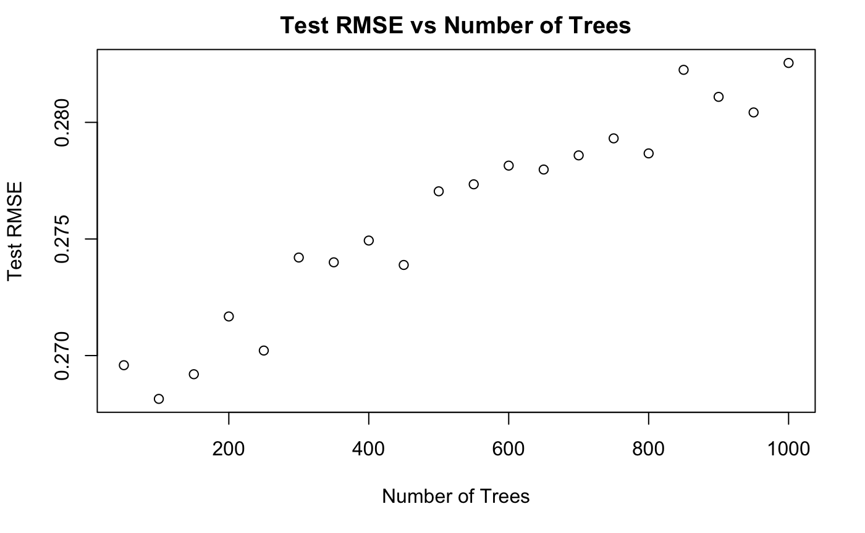
Boosting: Tuning Number of Trees
Interaction depth at 21
Iterated through number of trees from 50 to 1000
Each iteration increased the number of trees by 50

Slide 29
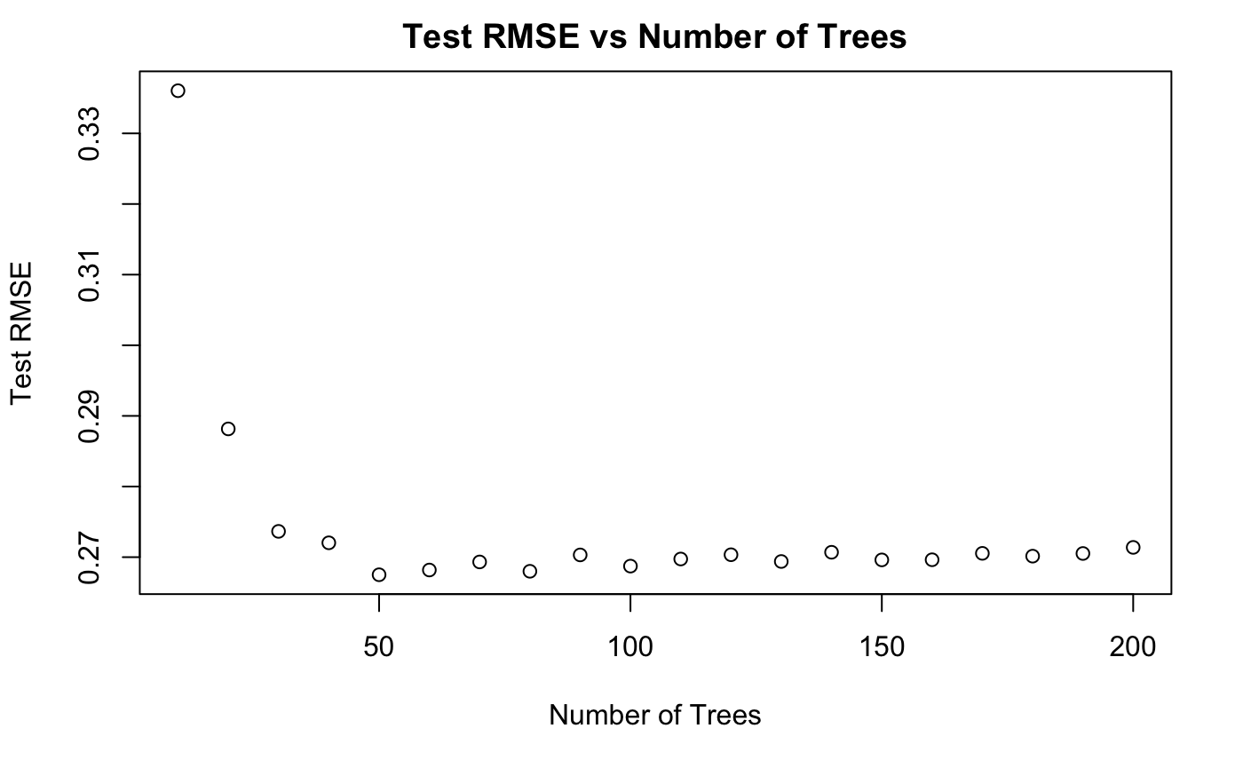
Boosting: Tuning Number of Trees
Interaction depth at 21
Iterated through number of trees from 10 to 200
80 trees
Each iteration increased the number of trees by 10
0.2674
Test RMSE =

Slide 30
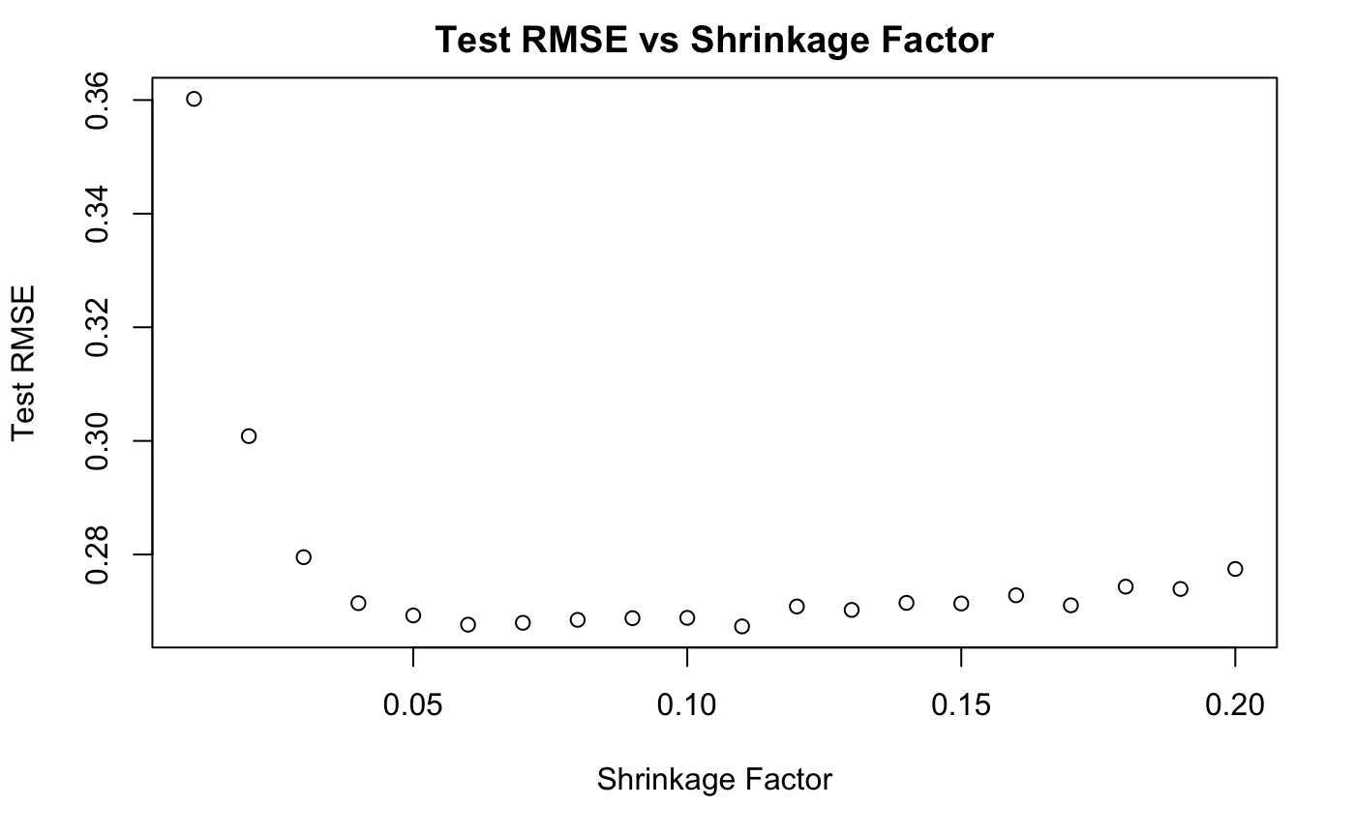
Boosting: Tuning Shrinkage Factor
Interaction depth = 21
Iterated through shrinkage factor from 0.01 to 0.2
n.trees = 80
0.11
Test RMSE =
0.2673

Slide 31
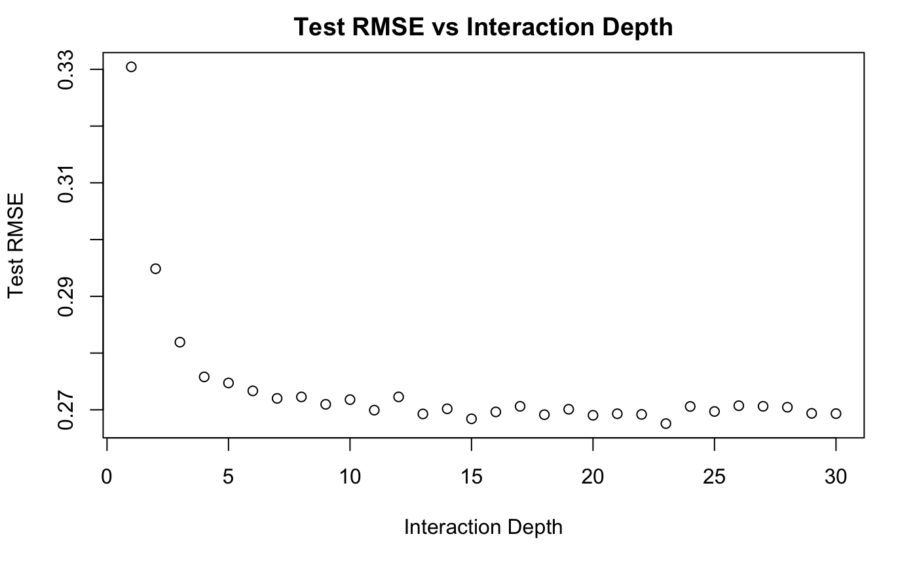
Boosting: Tuning Interaction Depth
n.trees = 80
Shrinkage Factor = 0.11
Iterated through interaction depth from 1 to 30
23
Test RMSE =
0.2676

Slide 32
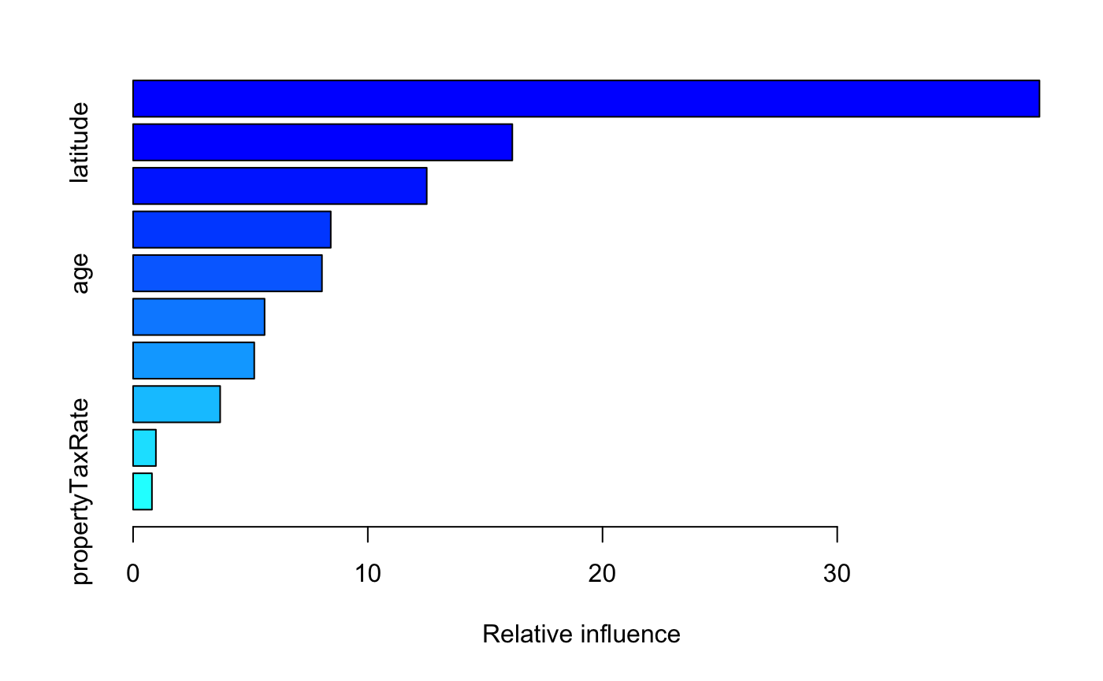
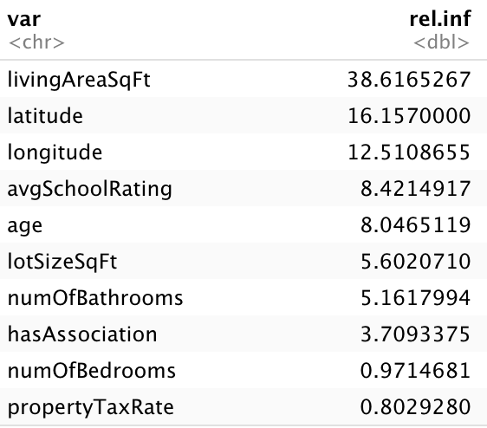
Boosting: Tuned Model 1
n.trees = 75
Shrinkage Factor = 0.1
Interaction depth = 21
Test RMSE =
0.2678

Slide 33
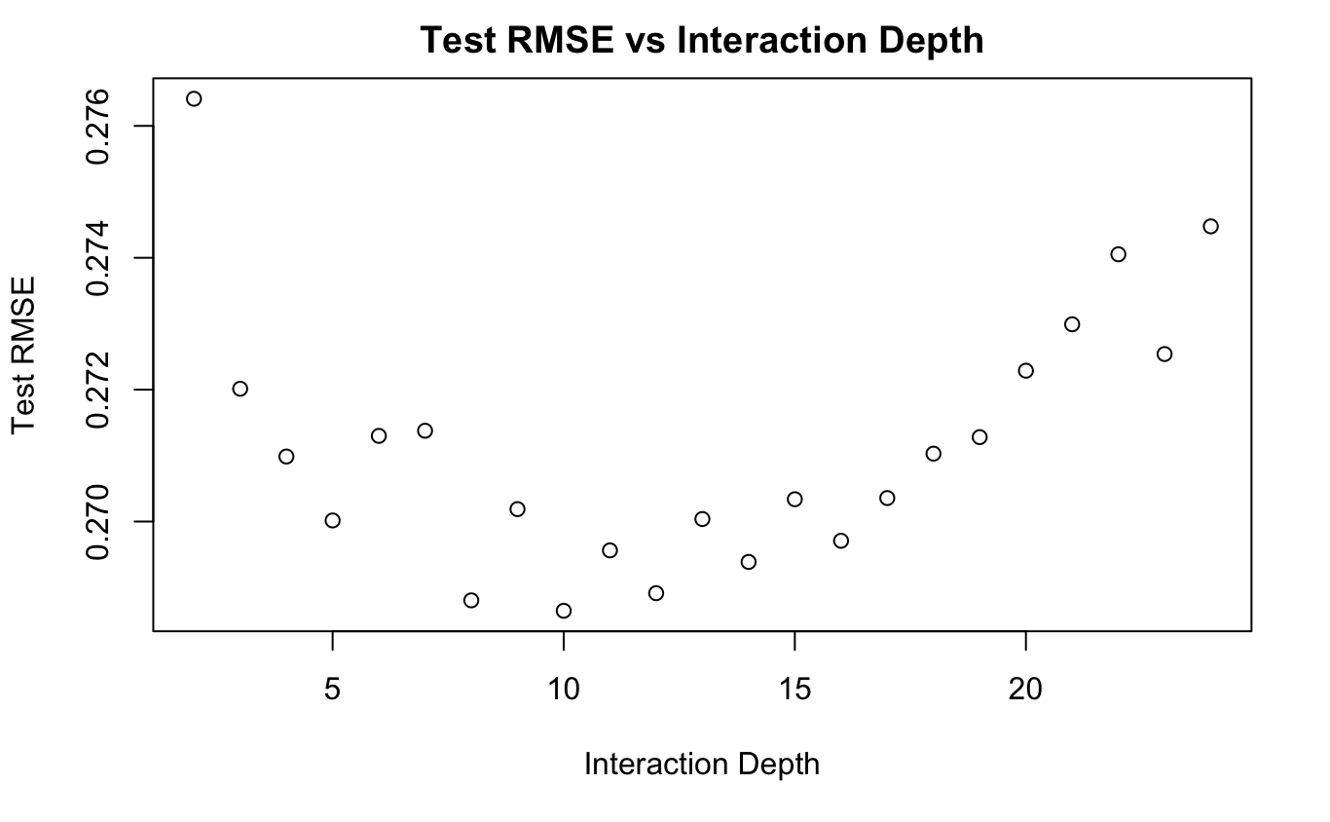
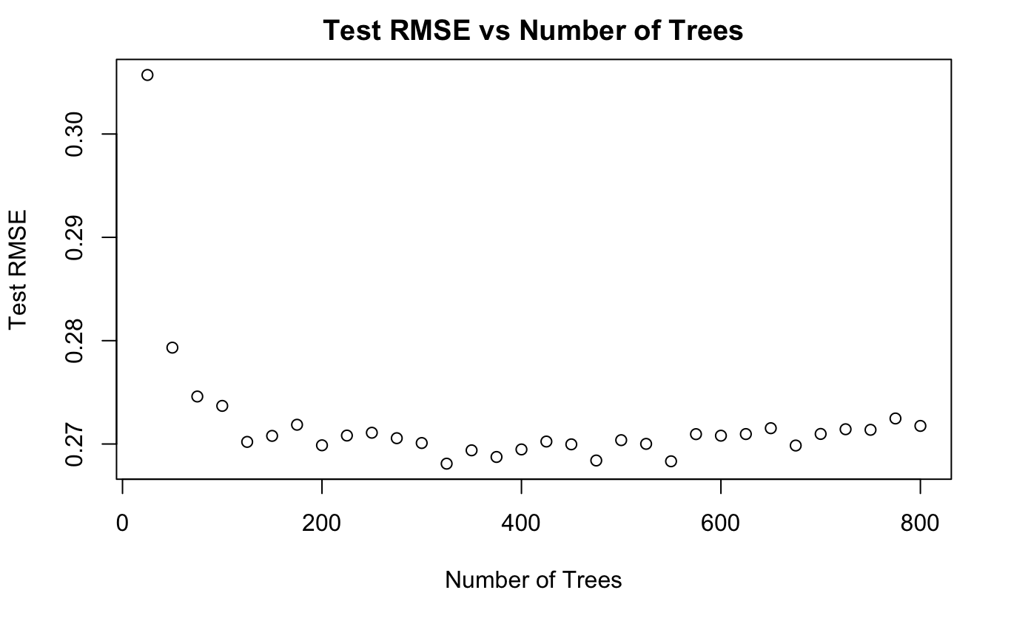
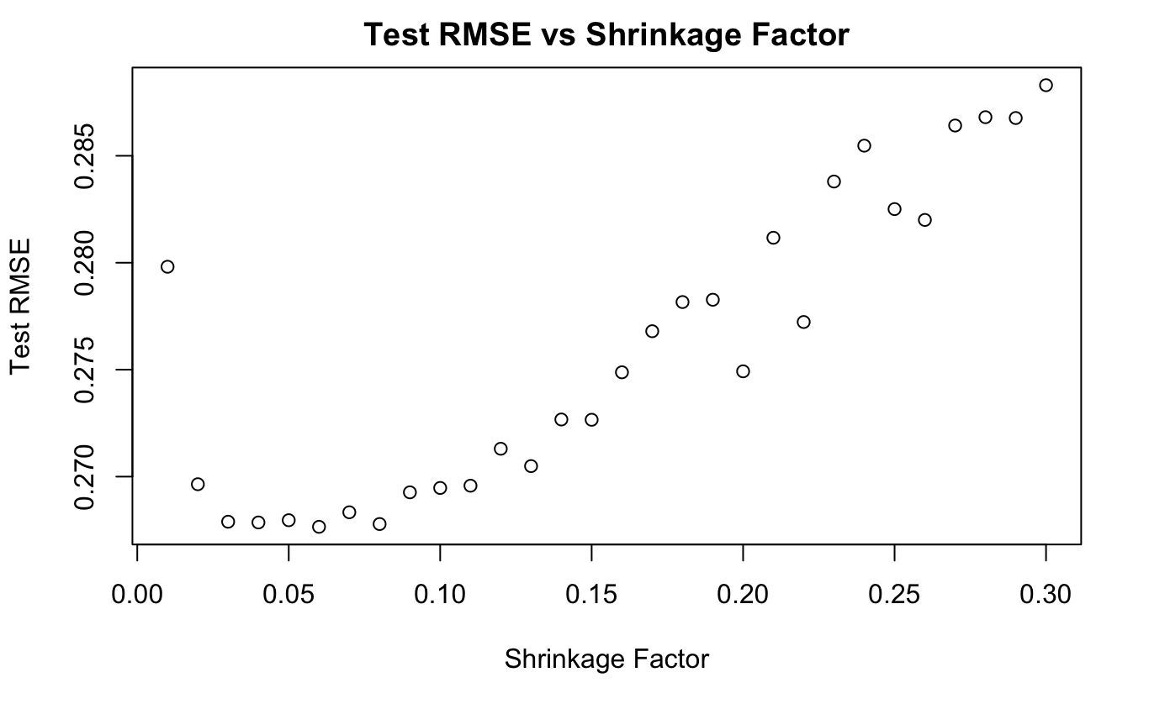
Boosting: Tuned Model 2
10
375
0.06
Interaction depth = 10
n.trees = 375
Shrinkage Factor = 0.06
0.2625
Test RMSE =

Slide 34
Exploratory Data Analysis
Feature Selection
Data Preparation
Modelling
Model Improvement
Model Selection
Results
Conclusions:
Based on Test RMSE, boosting is the best performing model on our dataset
The difference between Random Forest and Boosting Test RMSE is insignificant and does not justify the additional time spent on it
Model Specification | Test RMSE
Log-Linear Model | 0.3139
Ridge Regression | 0.3081
Lasso Model | 0.3047
KNN (Gaussian Weighted KNN) | 0.2741
Regression Tree | 0.3358
Bagging | 0.2722
Random Forest | 0.2674
Boosting (Tuned Model 2) | 0.2625
Notes:
To conclude, as progressed through the models, we saw a dip in rmse
Boosting was the best performing model on our dataset
But at the sametime, the difference between random and boosting rmse is insignificant and we’d rather use rf which is comparatively less computationally expensive and takes less time

Slide 35
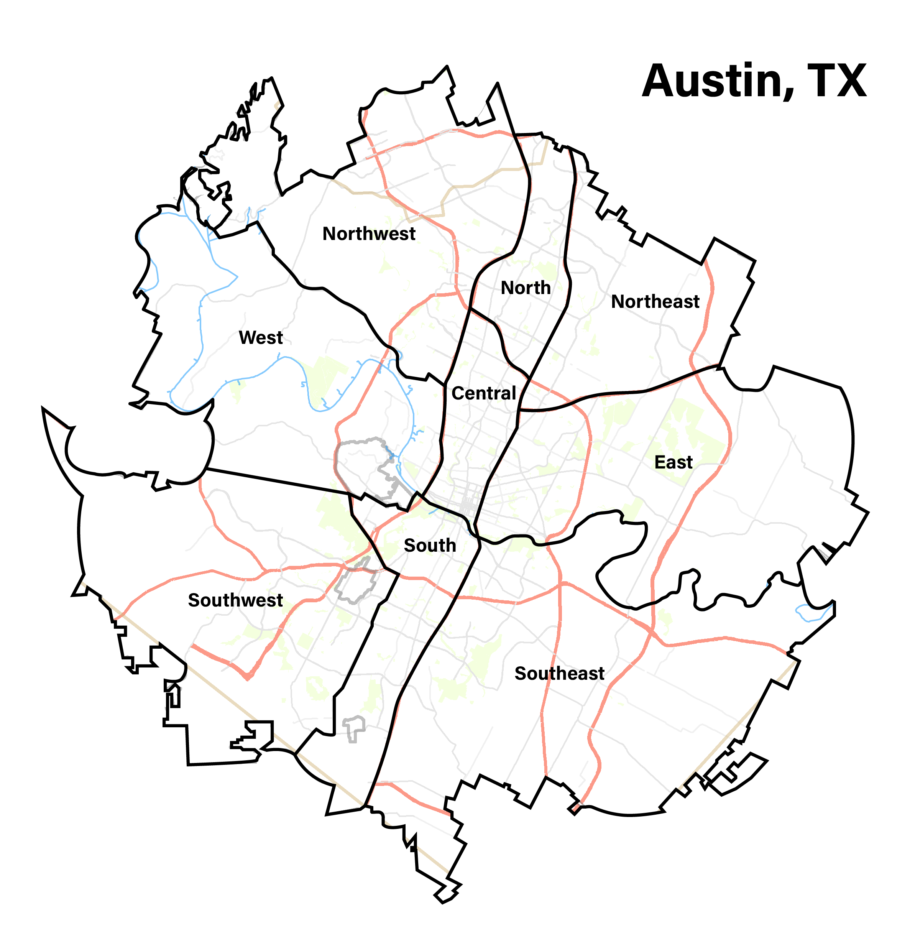
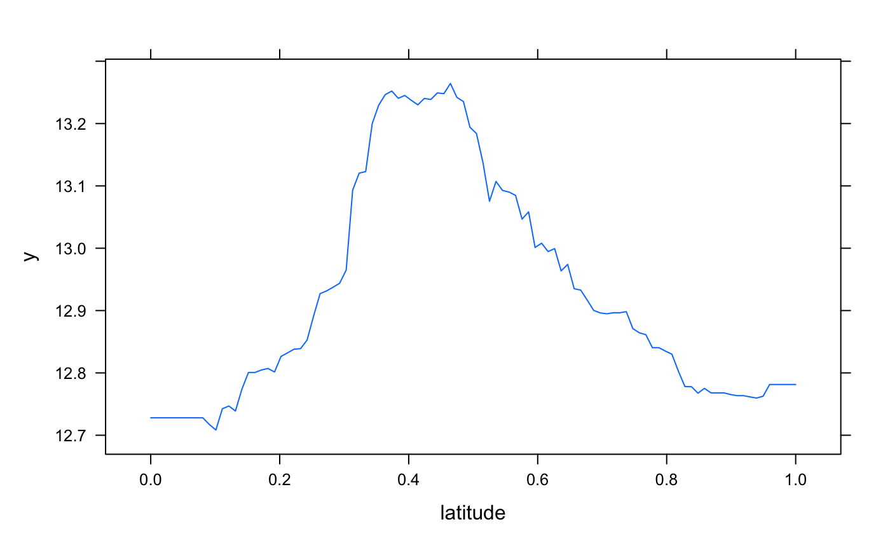
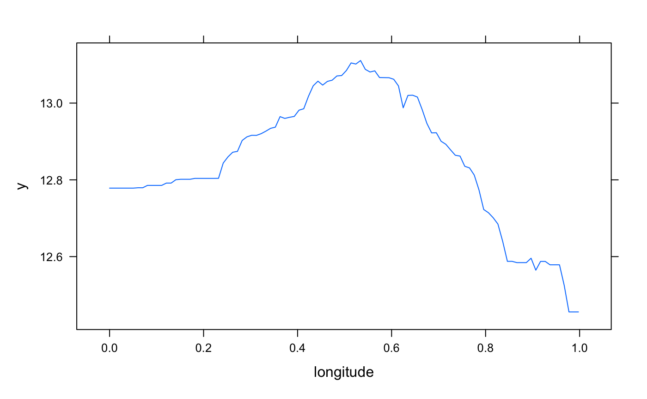
Geographical Significance
Notes:
What you see here on left hand side is latitude and longitude mapped against the price predicted by our best performing model i.e boosting
As you can see both the graphs suggest that central Austin is the most expensive part of Austin
The longitude graph suggests that west Austin is more expensive than East Austin
We found this very interesting look at because it compares what we predicted with what we already know about Austin and this just validates our work

Slide 36
Works Cited
Pierce, Eric. “Austin, TX House Listings.” Kaggle, 12 Apr. 2021, https://www.kaggle.com/datasets/ericpierce/austinhousingprices.
https://www.listendata.com/2015/07/gbm-boosted-models-tuning-parameters.html
https://www.recenter.tamu.edu/data/housing-activity/#!/activity/MSA/Austin-Round_Rock
Notes:
That’s it from our side, thank you for staying tuned. Do you have any questions for us?

